Slide 1
Analyzing Amazon Sales Data
Prashant Kunal

Slide 2
Context
Introduction
Data Exploration
Analysis
Graphical Representation
Strategy
Summary

Slide 3
Introduction
The project involves the analysis and visualization of sales data from an Amazon dataset to derive meaningful insights for a commercial and business enterprise. The primary objectives include understanding month-wise, year-wise, and yearly month-wise sales trends, identifying key metrics and factors influencing sales, and establishing meaningful relationships between attributes. Through Extract-Transform-Load (ETL) processes, the project aims to uncover patterns, optimize distribution methods, reduce costs, and enhance overall profitability. The analysis encompasses strategic considerations such as product focus, seasonal adjustments, supply chain optimization, cost management, strategic pricing, customer segmentation, technology integration, and continuous improvement. Visualizations, including line charts, bar charts, and pie charts, are employed to convey these insights effectively. The ultimate goal is to empower decision-makers with actionable information to navigate increasing competition and improve the crucial function of sales management within the enterprise.

Slide 4
Data Exploration:
Loaded the Amazon dataset and inspected its structure.
Transformed data, converting 'Order Date' to datetime format for time-based analysis.
Calculated summary statistics for a quick overview of the dataset.
Addressed missing data, ensuring the dataset's completeness.
Explored temporal trends, extracting month and year for time-based analysis.
Utilized groupby operations to aggregate data at different levels (e.g., monthly, yearly).
Created visualizations (line charts, bar charts, pie charts) for effective representation.
Conducted correlation analysis to understand relationships between variables.
Calculated key metrics like yearly sales, average sales, and item-wise total cost.
Derived insights guiding strategies for optimization in distribution, cost reduction, and profit increase.

Slide 5
Monthly Sales Trend Analysis
Month-wise sales trend analysis provides a concise yet powerful snapshot of a business's performance over time. By dissecting sales patterns on a monthly basis, this analysis offers strategic insights that inform crucial decisions. It enables businesses to discern peak months for specific products, facilitating optimized inventory management, targeted marketing campaigns, and efficient resource allocation. The analysis guides businesses in aligning product launches, pricing strategies, and supply chain operations with predictable fluctuations in customer demand. Ultimately, month-wise sales trend analysis proves instrumental in enhancing operational efficiency, customer engagement, and overall adaptability to dynamic market conditions.

Slide 6
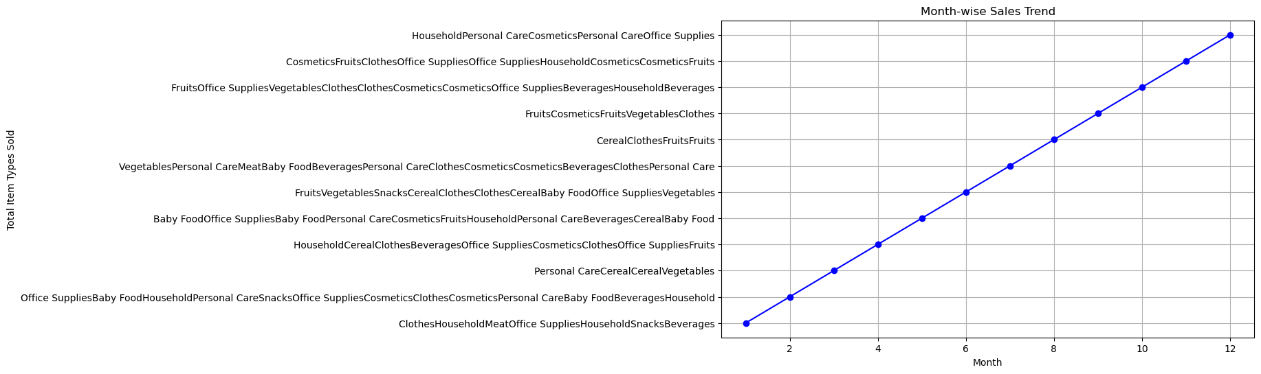

Slide 7
Yearly Sales Trend Analysis
Year-wise sales trend analysis presents a comprehensive overview of a business's financial performance, showcasing the total cost of different item types across each year. This analysis enables a strategic understanding of the evolving revenue landscape, helping businesses identify consistent growth, periods of contraction, or shifts in product popularity. By visualizing the yearly sales trends, organizations can make informed decisions regarding inventory management, marketing strategies, and resource allocation. The analysis serves as a critical tool for long-term planning, allowing businesses to adapt strategies based on historical sales patterns, ultimately contributing to sustained profitability and competitiveness in the market.

Slide 8
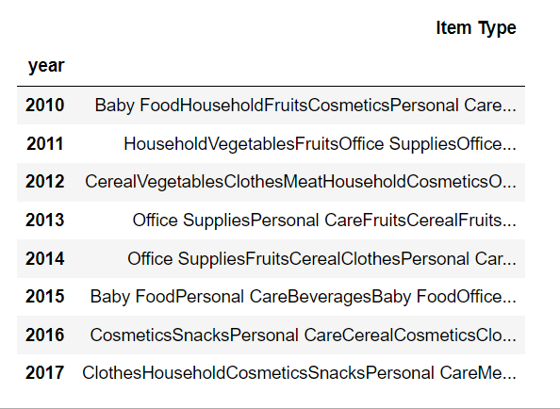
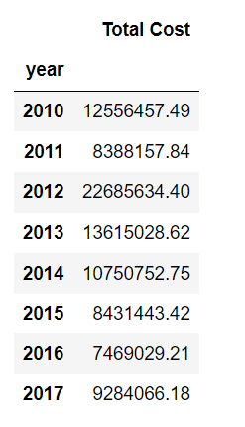
Item Type And Total Sales Of Every Year

Slide 9
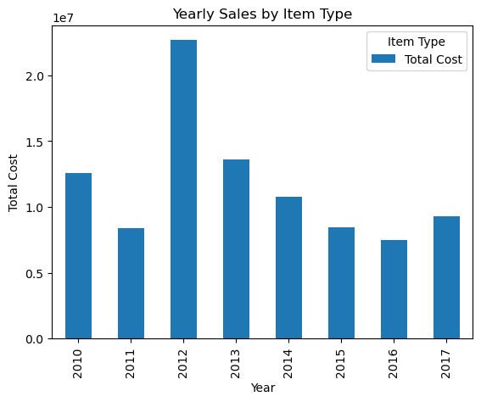

Slide 10
Yearly Month wise Sales Trend
The Yearly Month-wise Sales Trend graph offers a visual representation of how the total cost of items evolves over the months for each year. Each line on the graph corresponds to a specific year, allowing for a clear comparison of sales patterns across different periods. Observing the graph enables quick identification of peak months, seasonal trends, and variations in sales performance over the years. This visual summary is instrumental for strategic decision-making, as it provides insights into the temporal dynamics of sales, guiding businesses in optimizing inventory, planning marketing strategies, and adapting operations to align with historical sales patterns.

Slide 11
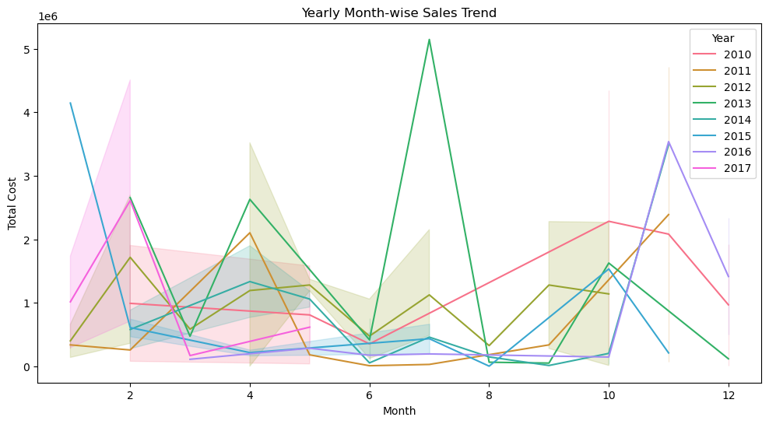

Slide 12
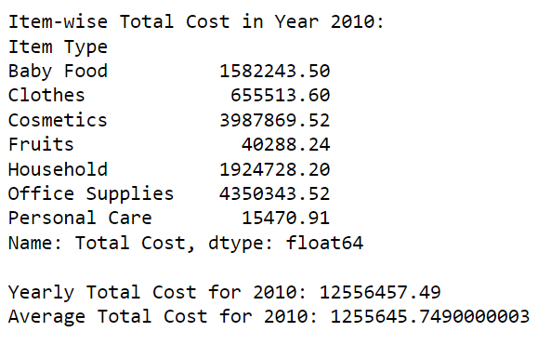
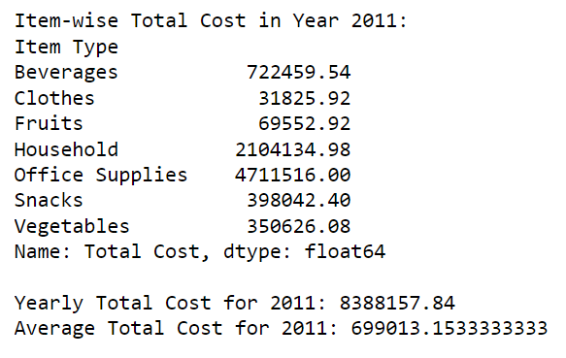
Item Wise Total Cost Of Every Year
Item-wise total costs in every year provide a granular understanding of the financial performance of each product category over time. This analysis breaks down the total costs associated with different items, offering insights into the profitability and contribution of each product to the overall business. By examining yearly trends, businesses can identify top-performing items, anticipate shifts in consumer preferences, and strategically allocate resources. This detailed view facilitates informed decision-making, guiding actions such as inventory management, pricing strategies, and product development. The annual assessment of item-wise total costs serves as a valuable tool for businesses seeking to optimize their product portfolio and enhance overall financial sustainability.

Slide 13
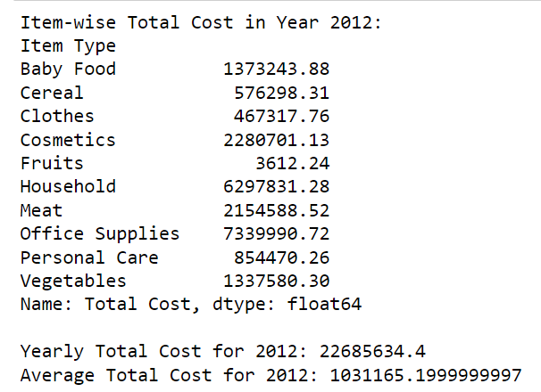
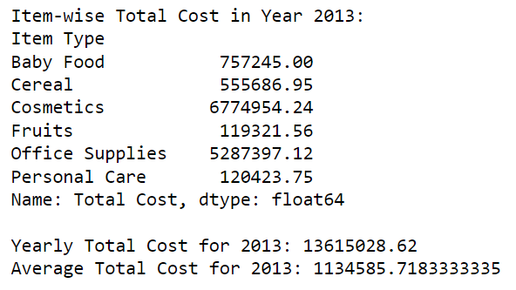
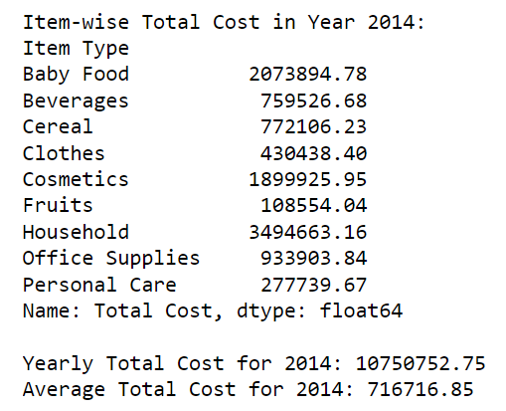
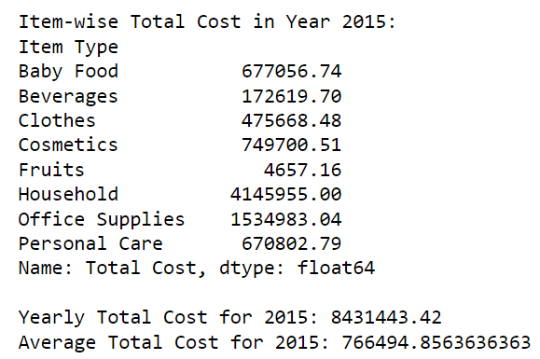

Slide 14
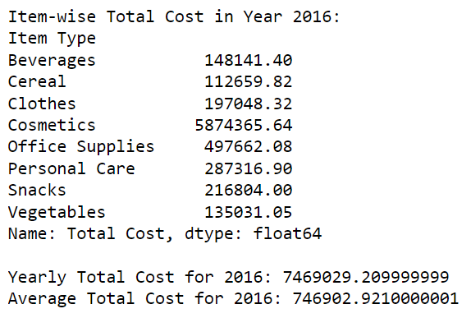
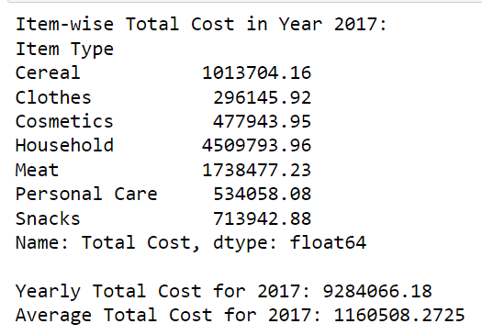

Slide 15
Data Transformation
Data transformation is a crucial step that converts raw data into actionable insights. When applied to yearly sales data, it allows businesses to identify the top-selling and lowest-selling items. This process involves grouping data by year and employing aggregation functions to reveal patterns and trends. By understanding the popularity of specific products over time, businesses can make informed decisions regarding inventory management, marketing strategies, and resource allocation. Data transformation acts as a bridge between raw data and strategic insights, empowering businesses to adapt and thrive in a dynamic market environment.
Years | Top Selling Item Type | Lowest selling Item type
2010 | Office Supplies | Personal Care
2011 | Office Supplies | Clothes
2012 | Office Supplies | Fruits
2013 | Cosmetics | Fruits
2014 | Household | Fruits
2015 | Household | Fruits
2016 | Cosmetics | Cereal
2017 | Household | Clothes

Slide 16
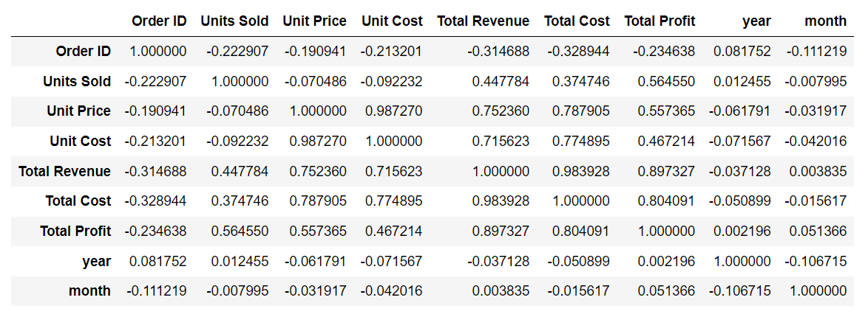
Relationship Analysis
In the context of sales analysis, it helps identify connections between factors such as total cost, item types, and sales channels. The correlation coefficients range from -1 to 1, indicating the strength and direction of relationships. Positive values signify positive correlations, while negative values suggest inverse relationships. Utilizing the correlation matrix aids businesses in understanding how variables interact, enabling data-driven decision-making for optimized strategies and improved overall performance.

Slide 17
Visualisation
In the visualization part of this project, various graphs were employed to distill meaningful insights from the sales data. Monthly Sales Trend analysis utilized line charts and bar graphs to depict fluctuations in sales over each month. Yearly Sales Trend analysis employed similar charts to highlight overall trends across different years. Yearly Month-wise Sales Trend was visualized through line and bar charts, offering a detailed view of monthly variations over multiple years. The code also included customized color palettes for better distinction. Additionally, pie charts were used to showcase monthly sales distribution. The project's visualizations effectively communicated complex sales patterns, aiding in strategic decision-making, inventory management, and marketing strategies. Overall, the diverse range of graphs provided a comprehensive understanding of the sales data, facilitating actionable insights for improved business performance.

Slide 18
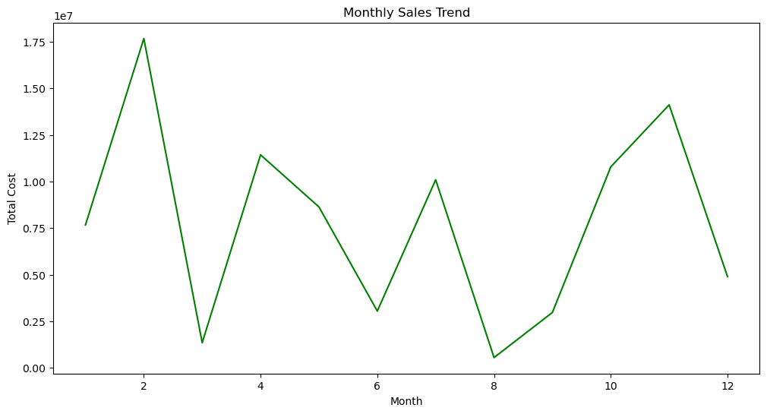
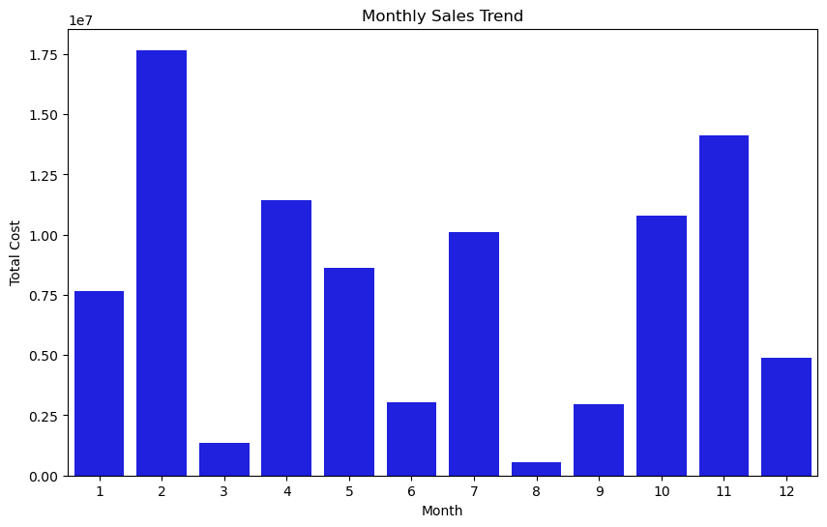
Graphical Representation

Slide 19
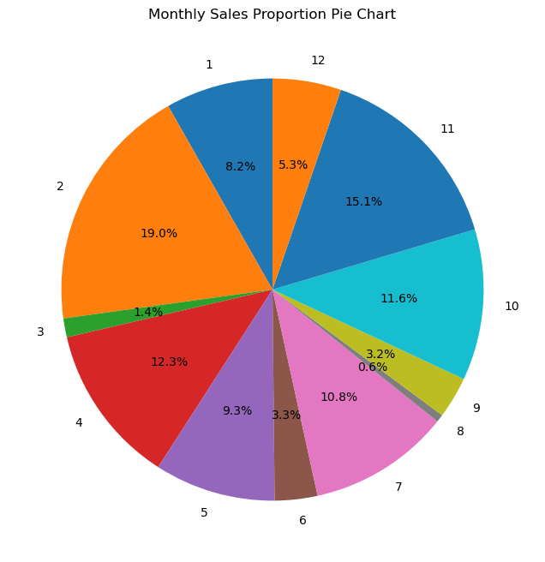

Slide 20
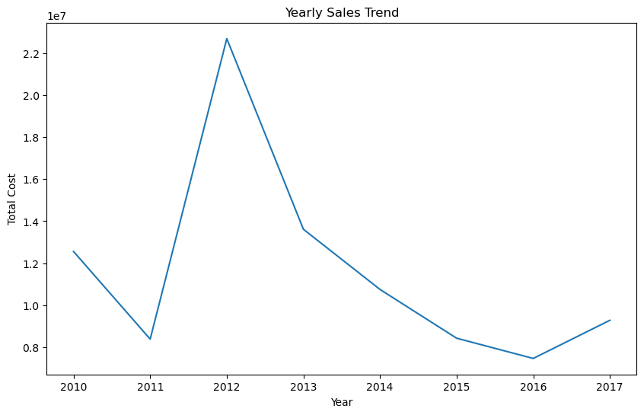
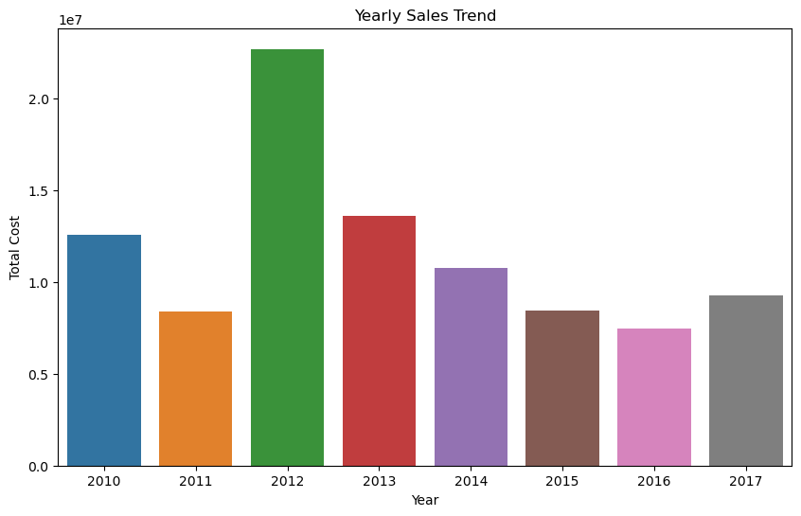

Slide 21
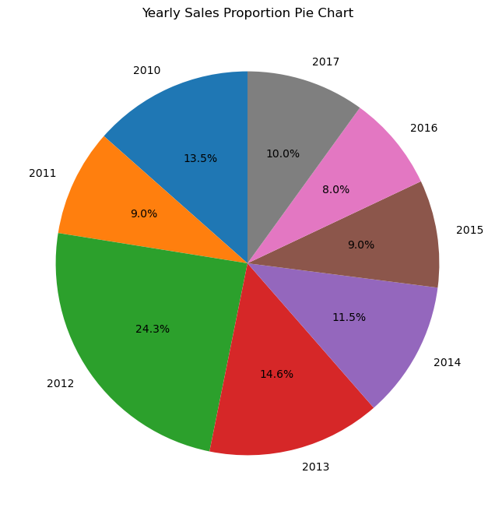

Slide 22
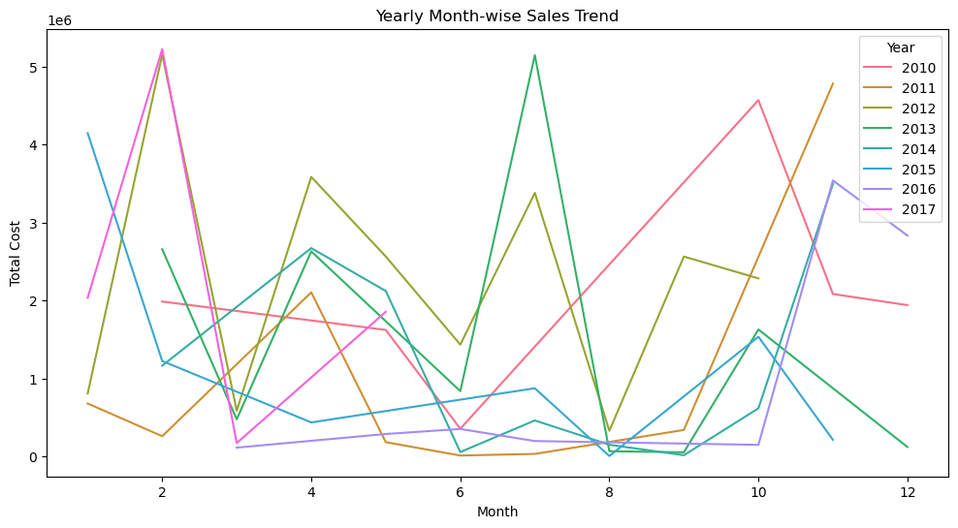

Slide 23
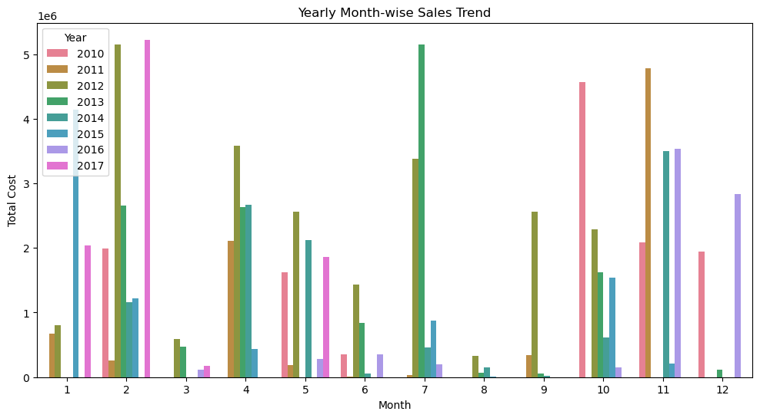

Slide 24
Strategy:
Product Focus: Prioritize top-selling products for optimized distribution and explore bundling strategies.
Seasonal Analysis: Adjust inventory and marketing efforts based on yearly month-wise sales trends.
Supply Chain Optimization: Streamline supply chains, negotiate better terms, and embrace technology for efficiency.
Cost Management: Analyze item-wise total costs, negotiate with suppliers, and optimize operating expenses.
Strategic Pricing: Adjust pricing based on year-wise sales and average sales, utilize promotions strategically.
Customer Segmentation: Tailor distribution based on customer behavior, implement loyalty programs for personalized approaches.
Technology Integration: Embrace technology for advanced inventory management, analytics, and e-commerce.
Continuous Improvement: Monitor and adapt strategies based on market changes, customer feedback, and industry trends. Foster a culture of continuous improvement within the organization.

Slide 25
Summary
This project focused on sales management strategies for optimizing distribution, reducing costs, and increasing profits in a commercial enterprise. Through ETL processes on an Amazon dataset, the analysis included monthly and yearly sales trend visualizations, key metric assessments, and relationship analyses. Strategies were proposed, incorporating product focus, seasonal insights, supply chain optimization, cost management, strategic pricing, customer segmentation, technology integration, and a continuous improvement approach. The project aimed to empower businesses with actionable insights to enhance sales strategies, improve operational efficiency, and adapt to dynamic market conditions for sustained profitability.

Slide 26
Conclusion:
In conclusion, this project delved into comprehensive sales management strategies by analyzing an Amazon dataset. The focus on monthly and yearly sales trends, key metrics, and relationships between attributes provided valuable insights. Proposed strategies encompassed various facets such as product focus, seasonal adjustments, supply chain optimization, cost management, strategic pricing, customer segmentation, technology integration, and a commitment to continuous improvement. The project aimed to equip businesses with actionable recommendations to optimize distribution methods, reduce costs, and increase profits. Through visualizations and strategic implications, the analysis contributes to informed decision-making and long-term business success in a competitive landscape.

Slide 27
Thank you

